Slide 1
TCP/IP
Prepared by: Emadeldeen Abdallah
Supervisor: Dr. Mohamed Heshmat

Slide 2


Welcome

Slide 3

Identifying of TCP/IP
Transmission Control Protocol/Internet Protocol
TCP/IP model is a four-layer
TCP/IP is a protocol suite (Telnet, ARP, FTP, TFTP)
providing connection-oriented
Ensuring delivery of the data.

Slide 4
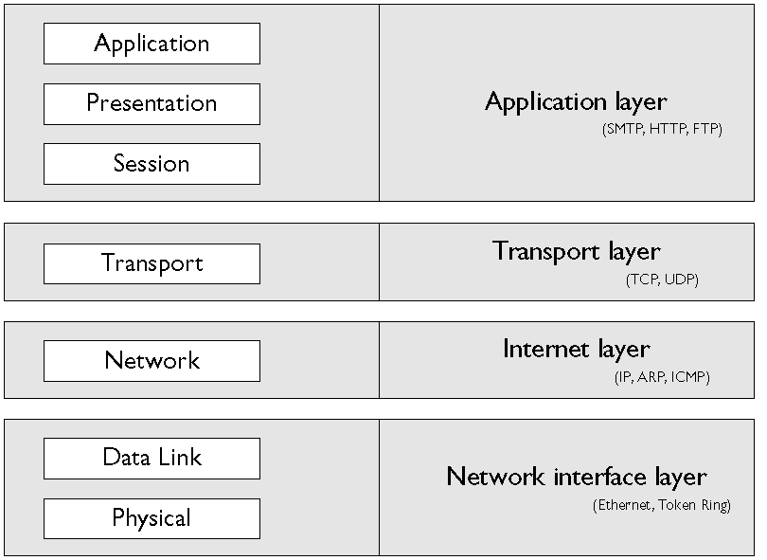
TCP/IP Model

Slide 5
Application Layer Protocols
HTTP Hypertext Transfer Protocol
  Allow clients to request web pages.
HTTPS Hypertext Transfer Protocol, Secure
    Encrypted format.
    Secure Sockets Layer (SSL).
    Used on e-commerce.
(SMTP) Simple Mail Transfer Protocol
    Send or route mail over a TCP/IP.
FTP File Transfer Protocol
    Upload and download files.

Slide 6
Transport Layer
(TCP) Transmission Control Protocol
  Acknowledgments.
(UDP) User Datagram Protocol
  Don’t require an acknowledgment

Slide 7
Internet Layer
(IP) Internet Protocol
    Logical addressing.
    Connectionless delivery system.
    Simply sends the data.
(ICMP) Internet Control Message Protocol
    Enable share status and error information
    Are encapsulated within IP datagrams
    Ping and Tracert uses ICMP protocol

Slide 8
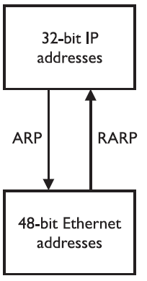
Internet Layer
(ARP) Address Resolution Protocol
    ARP request
    ARP reply
    RARP request
    RARP reply

Slide 9
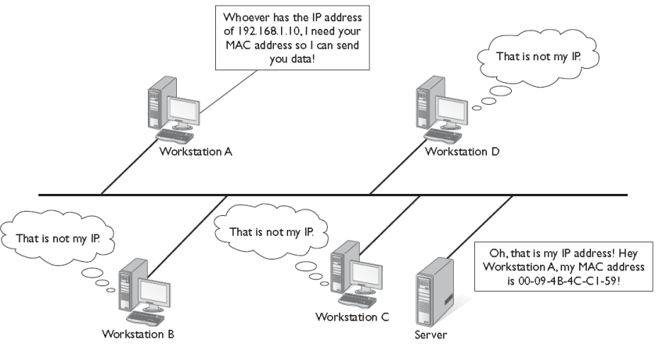
Internet Layer
(ARP) Working
ARP Cache (arp -a)

Slide 10
TCP/IP Fundamentals
IP address.
subnet mask.
Default gateway.

Slide 11
MAC Address
Physical Address
00-90-4B-4C-C1-59 (A->F and 0->9)
6 Octet
Octet = 8 bits
IP = 6 * 8 = 48 bits
4C-C1-59 | 00-90-4B
Unique for NIC | Unique for Company

Slide 12
IP Address
Logical Address
192.168.1.1
Four Octet
Octet = 8 bits
IP = 8 * 4 = 32 bits
2⁰ | 2¹ | 2² | 2³ | 2⁴ | 2⁵ | 2⁶ | 2⁷
1 | 2 | 4 | 8 | 16 | 32 | 64 | 128
1 | 1 | 168 | 192
00000001 | 00000001 | 10101000 | 11000000

Slide 13
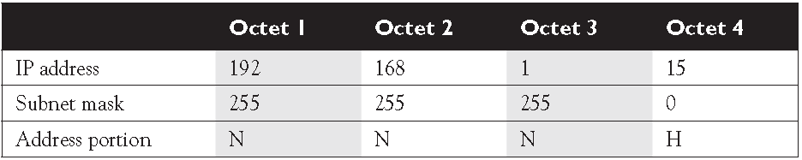
Subnet Mask
(N) -> Network ID (unique to network)
(H) -> Host ID (unique to system)
192.168.1.0 Network ID
192.168.1.255 Broadcast

Slide 14
Subnet Mask
Why parting to Network ID and a Host ID ?
Network IDs are the same, not use router
Network IDs are deferent, use router
Broadcast and traffic
Convert to VLAN

Slide 15
Default Gateway
Default Gateway Is an address for Router
Address as same as IP.
Purpose of router.
Why use Default Gateway ?
Sate 2 | State 1
192.168.1.1 | 192.168.1.1 | IP1
192.168.2.2 | 192.168.1.2 | IP2
255.255.255.0 | 255.255.255.0 | Subnet Mask
192.168.1.1 | 192.168.1.1 | Default Gateway
Yes | No | Use router

Slide 16
How computer Know if two systems have the same Network or No ?
System_2 | System_1
192.168.1.2 | 192.168.1.1 | IP
255.255.255.0 | 255.255.255.0 | Subnet Mask
System_2 | System_1
11000000 10101000 00000001 00000010 | 11000000 10101000 00000001 00000001
11111111 11111111 11111111 00000000 | 11111111 11111111 11111111 00000000
11000000 10101000 00000001 00000000 | 11000000 10101000 00000001 00000000
So have the same Network.

Slide 17
Two systems have same Subnet mask and The same Network ID,
Does that main they can Take each other?
System_2 | System_1
192.168.1.10 | 192.168.1.1 | IP
255.255.255.248 | 255.255.255.248 | Subnet Mask
System_2 | System_1
11000000 10101000 00000001 00001010 | 11000000 10101000 00000001 00000001
11111111 11111111 11111111 11111000 | 11111111 11111111 11111111 11111000
11000000 10101000 00000001 00001000 | 11000000 10101000 00000001 00000000
Don’t have the same Network.

Slide 18
Address Classes
Host Per Network | Subnet Mask | First Octet v IP
16,777,214 | 255.0.0.0 | 1 - 126 | Class A
65,534 | 255.255.0 | 128 - 191 | Class B
254 | 255.255.255.0 | 192 - 223 | Class C
multicasting applications |  | 224 - 239 | Class D
Experimental purposes |  | 240 - 247 | Class E

Slide 19
Loopback Address (127.0.0.1)
The loopback address is used to refer to the local system.
verify that the TCP/IP software has initialized on the local system

Slide 20
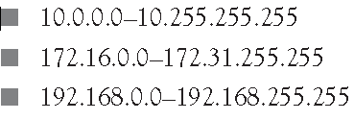
Private Addresses

Slide 21
Thank you
for
your attention

